Slide 1

Breaking MNIST: Evaluating Adversarial Robustness
MOSES MAKANGILA
Sofia University
CS2201: Artificial Intelligence
Professor A. Petiushko
March, 1, 2026

Slide 2
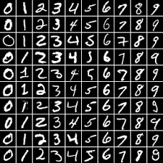
FINANCIAL INSIGHTS
Can High Accuracy Be Misleading?
Our CNN achieves 98.68% test accuracy.
At first glance, this looks excellent.
But accuracy on clean data does not tell us how stable the model is under adversarial perturbation
s
Notes:
This presentation explores how managerial accounting tools can ensure profitability, align with ethical leadership, and promote transparency.

Slide 3
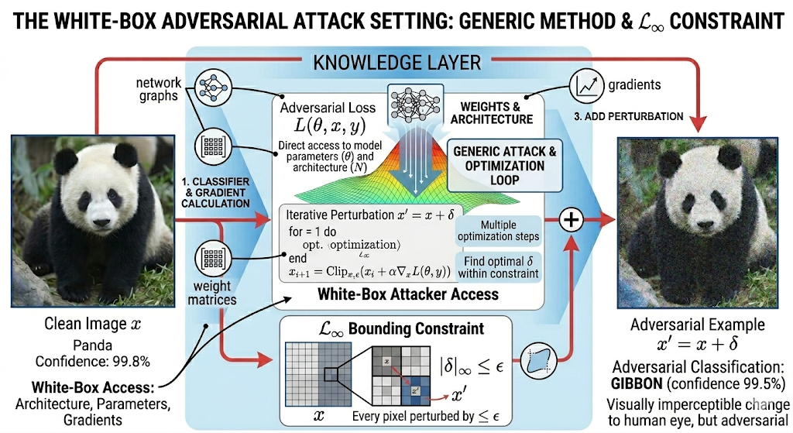
Threat Model: White-Box Adversary
FINANCIAL INSIGHTS
Notes:
We assume a white-box setting — the attacker has full access to gradients.
Perturbations are constrained by an L-infinity bound ε.
The goal is to cause misclassification while remaining visually imperceptible.

Slide 4
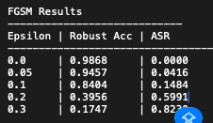
FINANCIAL INSIGHTS
Fast Gradient Sign Method (FGSM)
One gradient step
ε controls strength
Uses sign of gradient
Key Results (ε = 0.3):
Robust Accuracy: 17.47%
ASR: 82.3%
Notes:
With just one gradient step, performance drops dramatically.
At ε=0.3, over 82% of previously correct predictions are flipped.

Slide 5
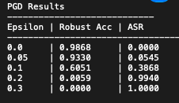
FINANCIAL INSIGHTS
Projected Gradient Descent (PGD)(Iterative Attack)
40 iterations
Small step size (α=0.01)
Projection to ε-ball
Key Results:
ε = 0.2 → Robust Acc: 0.59%
ε = 0.3 → Robust Acc: 0.00%
ASR ≈ 100%
Notes:
PGD is dramatically stronger.
At ε=0.2, the model is essentially destroyed.
At ε=0.3, the model fails completely.

Slide 6
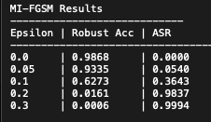
FINANCIAL INSIGHTS
Momentum I-FGSM : Momentum Improves Attack Stability
Accumulates gradients
Reduces oscillation
Similar strength to PGD
Key Results:
ε=0.3 → ASR: 99.94%
Robust Accuracy: 0.06%
Notes:
Momentum makes attacks even more stable and consistent.
The model is nearly entirely compromised.

Slide 7
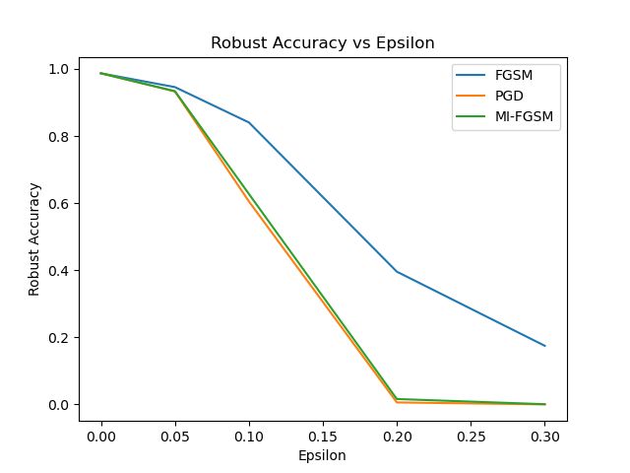
FINANCIAL INSIGHTS
Results Summary
Clean accuracy remains high
Sharp collapse under iterative attacks
FGSM degrades gradually
PGD collapses rapidly
Notes:
Notice the steep nonlinear drop for PGD and MI-FGSM.
Robustness does not degrade smoothly — it collapses.

Slide 8
FINANCIAL INSIGHTS
Results Summary
Attack success approaches 1.0 as epsilon increases.
By ε=0.3, nearly every correctly classified image can be flipped.

Slide 9
FINANCIAL INSIGHTS
Key Observations
High standard accuracy ≠ robustness
Iterative attacks are significantly stronger
Small perturbations cause catastrophic failure
Decision boundaries are fragile
Notes:
The model generalizes well on clean data,
but its decision boundary is extremely unstable under adversarial perturbations.

Slide 10
THANK YOU!

